Slide 1
Worksheet 1
In this worksheet, a template matching model was developed for person verification using CASIA-D Dataset.
Aim 1: To compare two different methods used to compute similarity scores for a template matching method
Euclidean distance vs. Correlation coefficient ​
Aim 2: To compare two different feature types:
Center-of-pressure (COP) vs. Center-of-area (COA)
Notes:
In this worksheet, a template matching model for verification task was developed.
The aim of this worksheet is to find the best model based on two different score matrixes.
In addition, we are going to compare COP and COA features.

Slide 2

Processing Pipeline 1: Feature Extraction​
Compute COP Time Series
COP features
3D .
footprint* .
(60,80,100)
Low Pass filter
(3,100)
Extracting hand craft features
(26,)
Converting to Binary Image (simple ** TH)
Compute COA Time Series
COA features (simple)
(60,80,100)
(3,100)
* CASIA-D: 97 subjects, 2851 samples (Each subject has about 30 Aligned Barefoot samples)
** Simple : if 0 then 0 (black), else 1-255 then 1 (white) ​
Notes:
Let start with the block diagram of the feature extraction.
As you can see, at first, I extracted the COP time series from each sample.
in the next couple of slides, we can see these signals.
Then these were passed through a low-pass filter.
with cut-off frequency of 5-Hz.
Finally, 26 handcraft features were extracted.
So each 3D sample translated to a 26-element vector.
+/-4.1 (18, 54)

Slide 3
Processing Pipeline 2: Feature Evaluation​
For each subject
COP features
Enrollment Process
Computing Model Score
Template Database
Computing EER & Threshold
COA features (simple)
(1) Matching Score​
Euclidean distance​
Correlation coefficient​
(2) Template Matching Criterion​
Minimum distance​
(3) Feature Type​
COP features
COA features (simple)
Notes:
Then for evaluating these features, a template matching model has been developed. In this worksheet, we focus on the training performance.

Slide 4
COP Time Series: AP, ML, RD​
Notes:
these three plots show the COP time series for the first sample of subject 4.

Slide 5
Center-of-Pressure (COP) Features​
Feature Extraction Methods​ |  | Dim​ | Type of COP Time Series​
MDIST | Mean Distance | 3 | MDIST_RD, MDIST_AP, MDIST_ML
RDIST | RMS Distance | 3 | RDIST_RD, RDIST_AP, RDIST_ML
TOTEX | Total Excursions | 3 | TOTEX_RD, TOTEX_AP, TOTEX_ML
MVELO | Mean Velocity | 3 | MVELO_RD, MVELO_AP, MVELO_ML
RANGE | Range | 3 | RANGE_RD, RANGE_AP, RANGE_ML
AREA | Confidence Circle/Ellipse Area, Sway area | 3 | AREA_CC, AREA_CE, AREA_SW
MFREQ | Mean Frequency | 3 | MFREQ_RD, MFREQ_AP, MFREQ_ML
FDPD | Fractal Dimension based on the Plantar Diameter of the Curve | 3 | FDPD_RD, FDPD_AP, FDPD_ML
FDCX | Fractal Dimension based on the 95% Confidence Circle/Ellipse | 2 | FDCC, FDCE
Notes:
From those signals, about 26 handcrafted features were extracted.
The detail of these features has been shown in this table.
I should mention that we've evaluated the feature groups in this worksheet, and in the next worksheet, each feature has been judged individually.

Slide 6
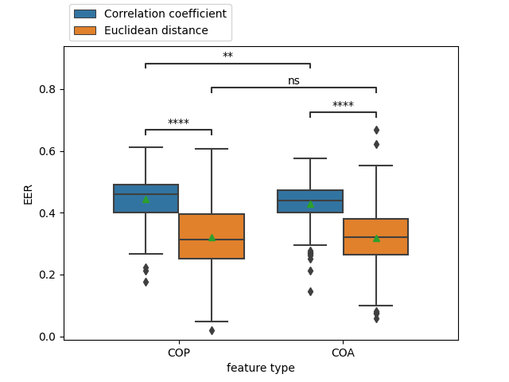
Euclidean distance vs. Correlation coefficient
Statistical test: Mann-Whitney
**: 1.00e-03 < p <= 1.00e-02
****: p <= 1.00e-04
Notes:
This box plot shows EER for COP and COA features. Based on these values,
the performance of the distance score is much better than the correlation one.
In addition, We must remember that COP and COA handcrafted features are not significantly different for the distance matrix.

Slide 7
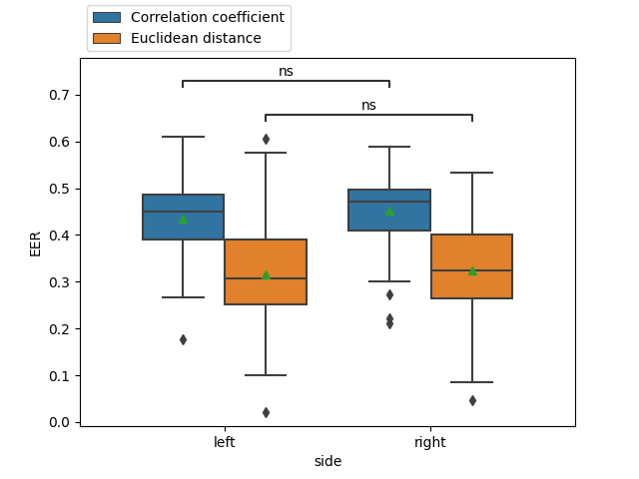
Euclidean distance vs. Correlation coefficient
Statistical test: Mann-Whitney
Notes:
In term of the left and right performance, EER values are not significantly different for both score matrices.

Slide 8
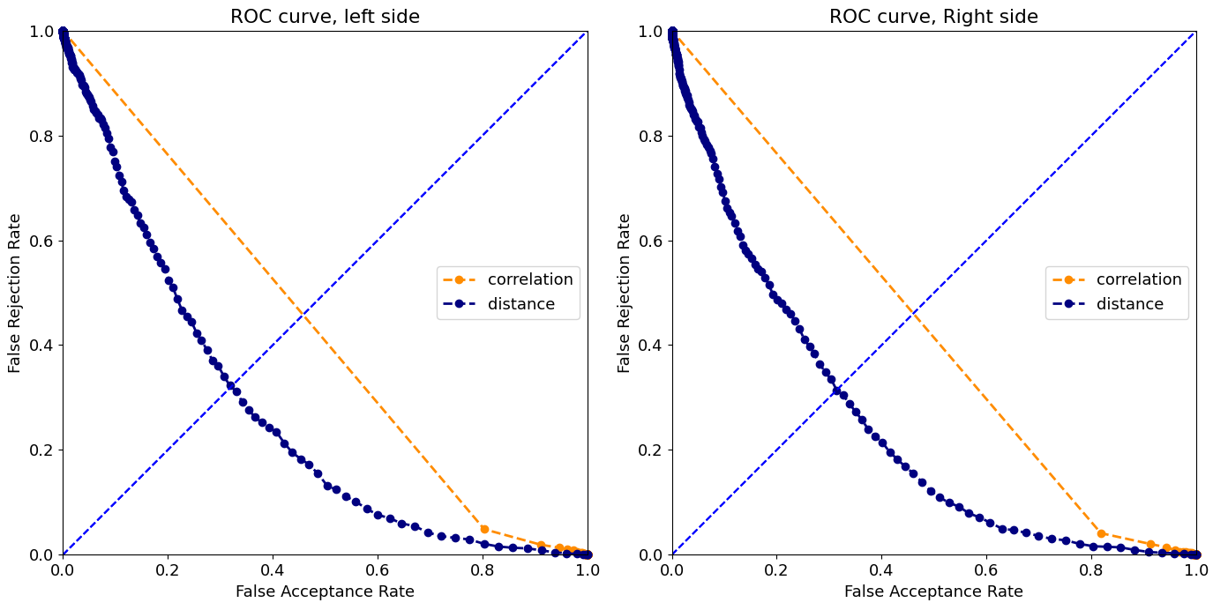
Receiver Operating Characteristic (ROC) Curve​
EER = 0.5
EER = 0.32
For each subject, two models were developed, left and right. As a result, we have 2*96 models, and
these two plots are obtained from the average of FAR and FRR in these models.
Notes:
Here is the ROC curve of these two models. The blue curve has a better AUC than another one.
These intersections indicate the EER value, which means FAR and FRR are equal.

Slide 9
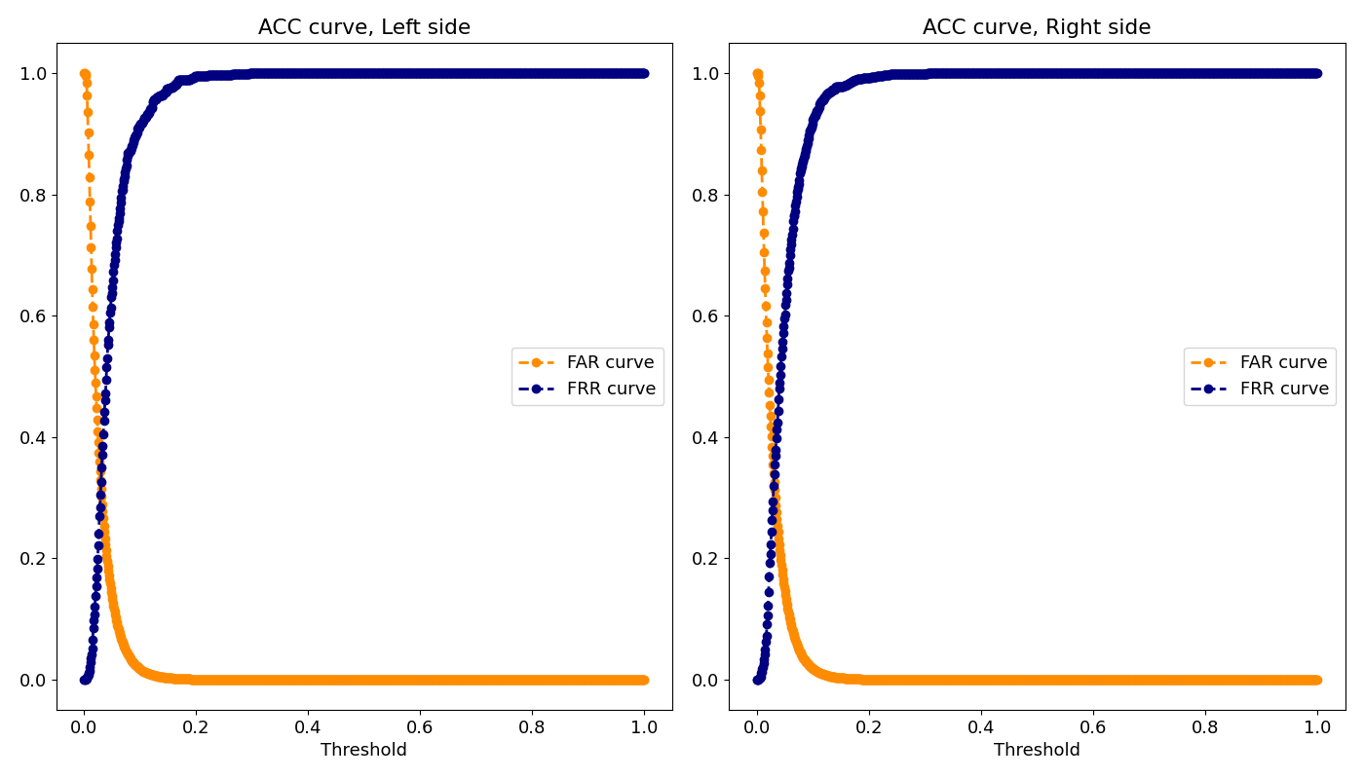
Accuracy Graph – Euclidean Distance​
For each subject, two models were developed, left and right. As a result, we have 2*96 models, and these two plots are obtained from the average of FAR and FRR in these models.
Notes:
Also, we are able to find EER from the accuracy graph. The x axis shows the different thresholds.

Slide 10
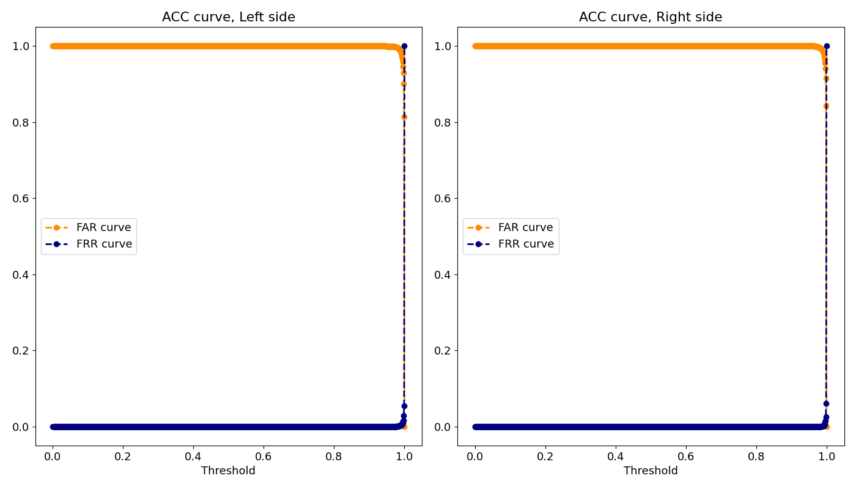
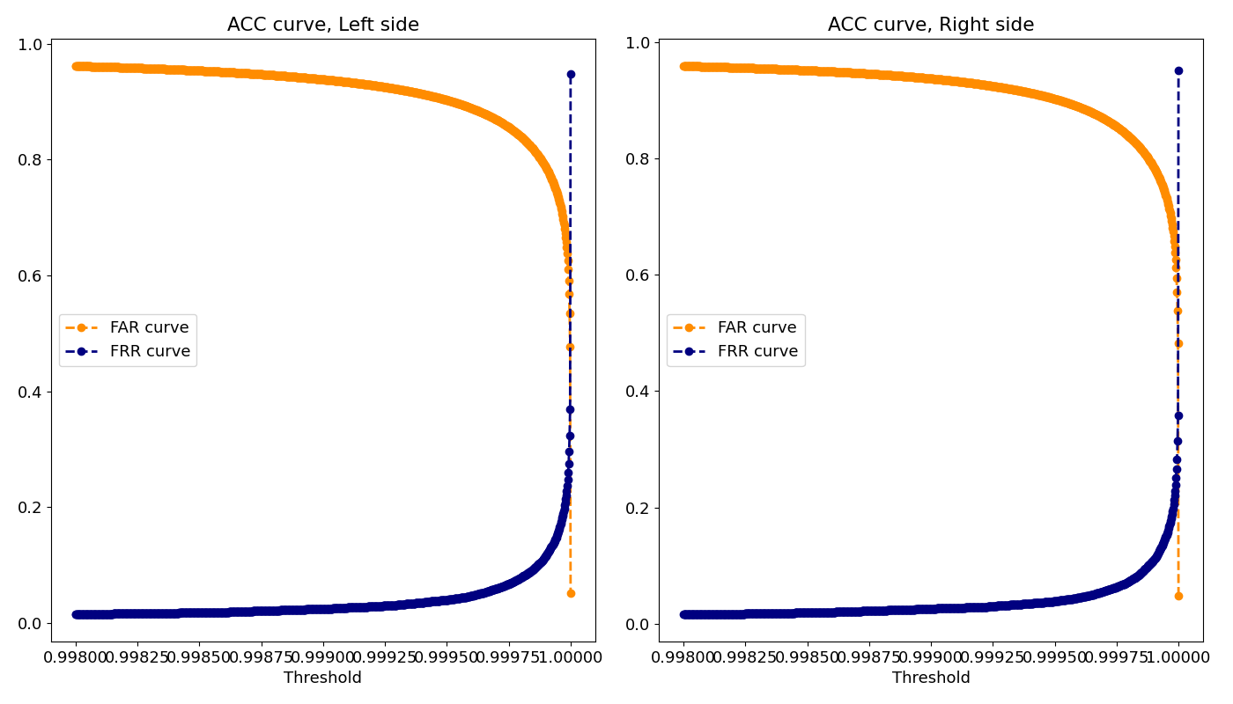
Accuracy Graph – Correlation Coefficient​
For each subject, two models were developed, left and right. As a result, we have 2*96 models, and these two plots are obtained from the average of FAR and FRR in these models.
Notes:
Also, we are able to find EER from the accuracy graph. The x axis shows the different thresholds.

Slide 11
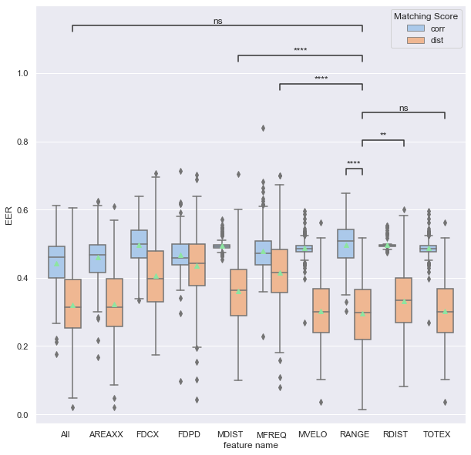
COP Features​
Statistical test: Mann-Whitney
**: 1.00e-03 < p <= 1.00e-02
****: p <= 1.00e-04
Notes:
Let's compare features based on the score matrix and feature group.
As you can see, the range feature is the best one in distance score
while it has the worse performance in correlation one.
The worse feature in the distance model also has the same EER as the best in correlation.
Another interesting thing is that the Range feature has a lower EER than the combination of all attributes but based on the statistical test is not significantly different.

Slide 12
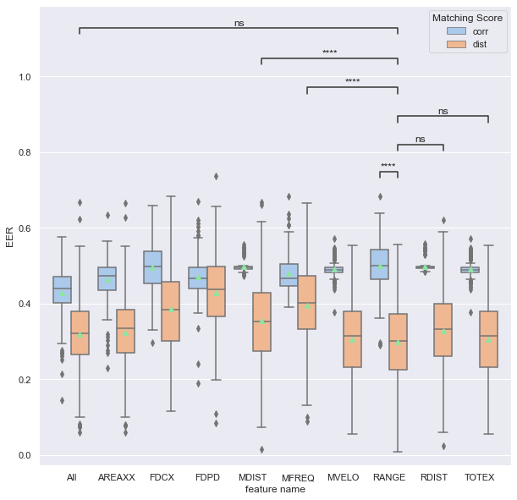
COA Features​
Statistical test: Mann-Whitney
**: 1.00e-03 < p <= 1.00e-02
****: p <= 1.00e-04
Notes:
For COA, we have the same point. RANGE feature has the best EER but based on the statistical test, this result is not significantly different for all features and RANGE.

Slide 13
COA Features vs. COP Features​
The average EER across all models based on different feature groups.
Notes:
In this slide, I am going to compare COA to COP features, based on average EER.
as these two tables show both feature types have the same performance almost

Slide 14
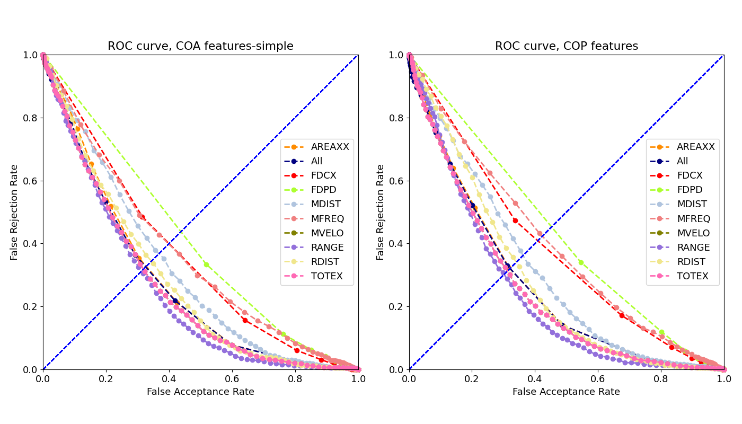
COA Features vs. COP Features​ (ROC curve)
For each subject, two models were developed, left and right. As a result, we have 2*96 models, and these two plots are obtained from the average of FAR and FRR in these models.
Notes:
here is the ROC curve of these COP features.

Slide 15
Conclusions
Euclidean distance showed a better performance than the correlation coefficient for barefoot-based gait authentication.​
Although CASIA-D has more right foot samples than left, both feet have the same results​.
Range feature has the best EER. Even its result is better than the combination of all features.​
The worse feature in distance score has the same EER as the best feature in correlation.
Both COA and COP have the same result for barefoot-based gait authentication.
Notes:
In conclusion,
Distance score has better performance
Left and right foot have the same results
Range feature has the best EER in COP features.
This performance is better than the combination all COP features.
The worse features in distance score has as much EER as the best feature in correlation.

Slide 16
Worksheet 3
This Worksheet focus on different feature types. Not only training performance but also testing performance were calculated for our template matching model.
Aim 1: To compare different test size​
Aim 2: To compare z-score and Min-Max algorithm
Aim 3: To compare different template matching criterion
​Aim 4: To compare different amount of PCs
​Aim 5: To compare different type of features
Notes:
This Worksheet fucus on different feature types,
Also not only training performance but also testing performance were calculated for our template matching model
The aim of this worksheet is to find the best model based on two different score matrixes.
In addition, we are going to compare COP and COA features.

Slide 17
Processing Pipeline 1: Feature Extraction​
Compute COP Time Series
(3,100)
(300,)
COP Time-series
3D footprint
Converting to Binary Image (simple TH)
(60,80,100)
Low Pass filter
(3,100)
Flatten TS
(300,)
COA Time-series (simple)
(60,80,100)
Converting to Binary Image (Otsu TH)
(60,80,100)
Compute COA Time Series
(3,100)
(300,)
COA Time-series (Otsu)
(26,)
COP features
Extracting features
(26,)
COA features (simple)
(26,)
COA features (Otsu)
Notes:
let's start with the feature Extraction Pipeline.
It is similar to worksheet one except for time series features.
We also used another technique for converting to a binary image called Otsu.
In this method, a dynamic threshold was used.

Slide 18
Processing Pipeline 2: Feature Evaluation​
COP Time-series
Splitting test and training set
Enrollment Process
COA Time-series (simple)
unflatten Time-series
Normalization & PCA
Computing Model Score
Template Database
Computing EER & Threshold
COA Time-series (Otsu)
Verification Process
COP features
Normalization & PCA
Computing Model Score
Calculating Accuracy, F1-score, FRR and FAR
COA features (simple)
SVM
COA features (Otsu)
As a classifier
Notes:
After extracting features, normalization and PCA were applied to these feature types.
In the next slide, I’d like to talk more about this red box.
Also, for comparing models, the accuracy was calculated.

Slide 19
Processing Pipeline 3: Feature projection​
Training set
RD
Normalization & PCA
AP
Normalization & PCA
RD
ML
AP
ML
Normalization & PCA
RD
ML
AP
RD
ML
AP
RD
ML
AP
Fitted model
RD
ML
AP
RD
ML
AP
test set
RD
Normalization & PCA
AP
Normalization & PCA
RD
ML
AP
ML
Normalization & PCA
RD
ML
AP
Notes:
To use PCA on time-series data, we need to apply PCA on each time series separately then PCs were concatenated to make a feature vector at the output.

Slide 20
Processing Pipeline 4: Enrollment Process​
Training Set
Training se
Client samples
Training Set
Enrollment Process
Client samples
Computing Model Score
Template Database
Computing EER & Threshold
Imposter samples
Randomly
Computing the average of EER
Imposter samples
It would repeat 50 times.
Notes:
Since our Dataset is unbalanced, so I randomly selected imposter samples as many as client samples. In order to make a balanced training set. Then we have reported the average of EER.
In other words, we calculated the EER and accuracy 50 times with different imposter samples in a balance training or test set,

Slide 21
Processing Pipeline 4: Verification Process​
Test Set
Training se
Client samples
Test Set
Verification Process
Client samples
Computing Model Score
Calculating Accuracy, F1-score and EER
Imposter samples
Randomly
Computing the average of Accuracy, F1-score, FAR and FRR
Imposter samples
It would repeat 50 times.
Notes:
Here we can see the same method that I have used for the verification process.

Slide 22
Conditions for Worksheet 3​
PCA
Without PCA
Template Matching Criterion​
Minimum distance
COP features
COA features (simple)
Average distance
Median distance
COA features (Otsu)
COP Time-series
COA Time-series (simple)
COA Time-series (Otsu)
Only 95% variance
Only 90% variance
Only 80% variance
Normalization algorithm
Z-score
Minmax
Test set size
10% ~ 90%
Notes:
As I said before, our purpose is to compare several algorithms to find out which one has the best performance.
So, This table shows the search space for this worksheet.

Slide 23
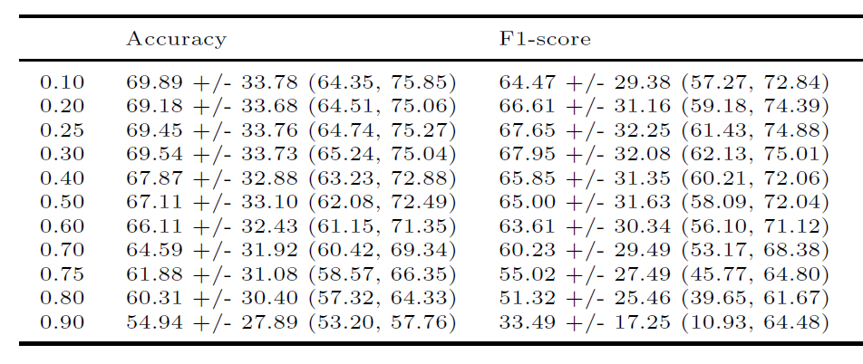
Test Size
Features Type | COP features
PCA | Only 95% variance
Normalization algorithm | Z-score
Score matrix | Distance, Correlation
Criteria | Min, Average, Median
Notes:
First, let find out the best portion of the test set.
As you can see, with increasing the test size, the performance of our model reduces. as a result,
I choose 30 percent since we have a good portion of the test sample, and the accuracy is acceptable.

Slide 24
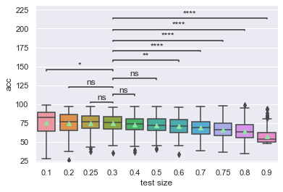
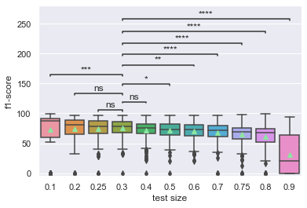
Test Size
ns: 5.00e-02 < p <= 1.00e+00
*: 1.00e-02 < p <= 5.00e-02
**: 1.00e-03 < p <= 1.00e-02
***: 1.00e-04 < p <= 1.00e-03
****: p <= 1.00e-04
Statistical test: Mann-Whitney
Notes:
First, let find out the best portion of the test set.
As you can see, with increasing the test size, the performance of our model reduces. as a result,
I choose 30 percent since we have a good portion of the test sample, and the accuracy is acceptable.

Slide 25
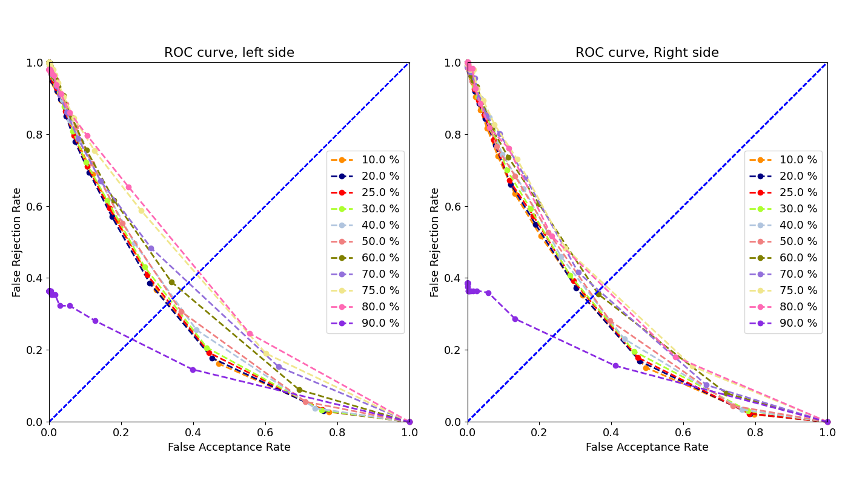
Test Size (ROC)
For each subject, two models were developed, left and right. As a result, we have 2*96 models, and these two plots are obtained from the average of FAR and FRR in these models.
Notes:
slide 25
here is the ROC curve of different test size.
1. EER (training) vs. CR (training) -> correlated
2. CR (training) vs. CR (testing) -> no correlate
If not correlated, it should be because of overfitting
3. EER (training) vs. CR (testing) -> no correlate
Overfit
When training -> relatively high, testing -> low
Underfit
When training -> low, testing -> low

Slide 26
Test Size
 | Left foot |  | Right foot
Test Size | training samples | test samples | training samples | test samples
10 % | 12.83 (6, 18)* | 1.56 (1, 2) | 13.63 (8, 32) | 1.61 (1, 4)
20 % | 11.51 (6, 16) | 2.89 (1, 4) | 12.19 (7, 29) | 3.05 (2, 7)
25 % | 10.81 (5, 15) | 3.58 (2, 5) | 11.45 (7, 27) | 3.79 (2, 9)
30 % | 10.21 (5, 14) | 4.19 (2, 6) | 10.72 (6, 25) | 4.52 (3, 11)
40 % | 8.64 (4, 12) | 5.76 (3, 8) | 9.15 (5, 22) | 6.09 (4, 14)
50 % | 7.04 (3, 10) | 7.35 (4, 10) | 7.51 (5, 18) | 7.73 (4, 18)
60 % | 5.76 (3, 8) | 8.64 (4, 12) | 6.09 (4, 14) | 9.15 (5, 22)
70 % | 4.39 (2, 6) | 10.01 (5, 14) | 4.70 (3, 11) | 10.54 (6, 25)
75 % | 3.58 (2, 5) | 10.81 (5, 15) | 3.79 (2, 9) | 11.45 (7, 27)
80 % | 2.89 (1, 4) | 11.51 (6, 16) | 3.05 (2, 7) | 12.19 (7, 29)
90 % | 1.36 (1, 2) | 13.03 (6, 18) | 1.44 (1, 4) | 13.80 (8, 32)
* Mean (min, max)
Notes:
slide 24
Here we can see the average of training and test samples for each test set.
The min and max number of samples are shown in parenthesis.

Slide 27
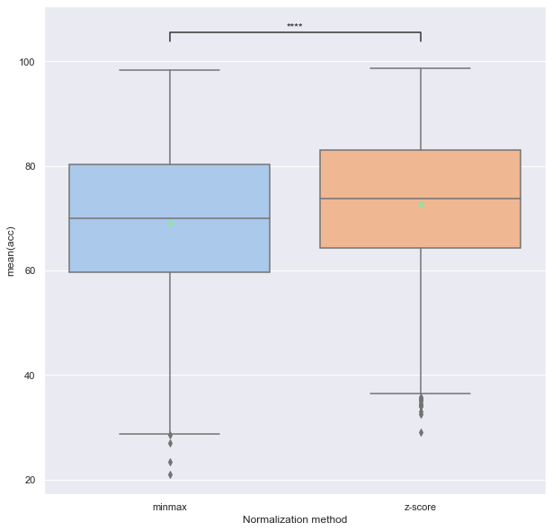
Normalization Algorithm
Statistical test: Mann-Whitney
****: p <= 1.00e-04
Features Type | COP features
PCA | Keeping 95% variance, Keeping 90% variance,
Score matrix | Distance
Criteria | Min, Average, Median
Notes:
slide 26
About the Normalization algorithm, I have just tested two algorithms, z-score and min-max.
As these box plots show,
z-score has better performance than Min-max.

Slide 28
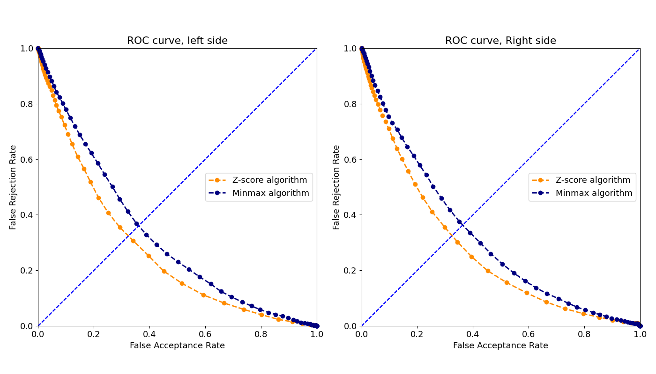
Normalization Algorithm (ROC)
For each subject, two models were developed, left and right. As a result, we have 2*96 models, and these two plots are obtained from the average of FAR and FRR in these models.
Notes:
slide 27
again the ROC curve of z-score and min-max.

Slide 29
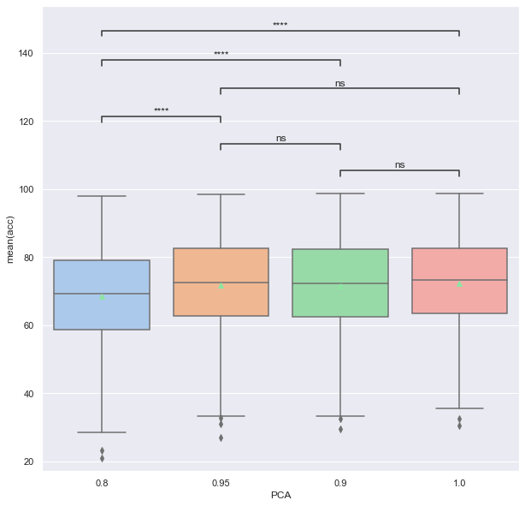
Principal Component Analysis (PCA)
Statistical test: Mann-Whitney
****: p <= 1.00e-04
Features Type | COP features
Normalization algorithm | Z-score, Min-Max
Score matrix | Distance
Criteria | Min, Average, Median
Notes:
slide 28
about PCA, the performance of models decreased since we lost some variance.
But I think keeping 95 percent could be a good choice
because it reduces feature space by about one-fourth with the same accuracy as without PCA.

Slide 30
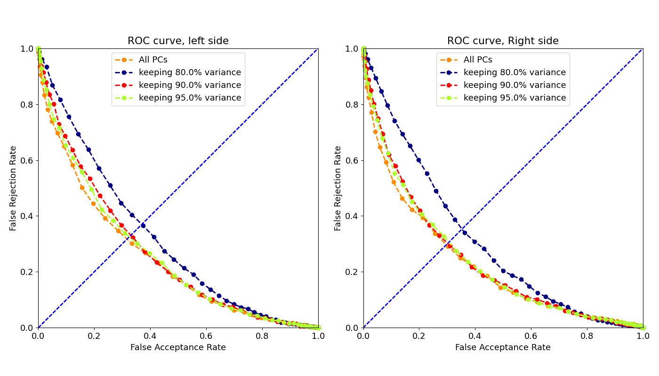
Principal Component Analysis (ROC)
For each subject, two models were developed, left and right. As a result, we have 2*96 models, and these two plots are obtained from the average of FAR and FRR in these models.
Notes:
slide 29 & 30
here is a boxplot of accuracy and ROC curve.

Slide 31
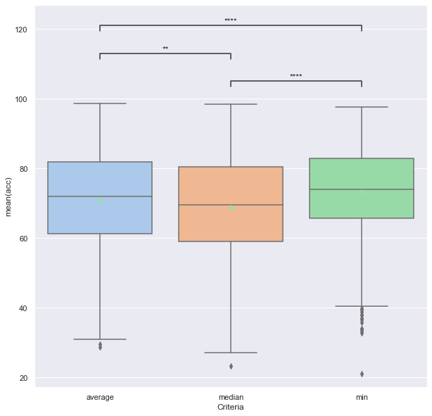
Template Matching Criterion​
Statistical test: Mann-Whitney
**: 1.00e-03 < p <= 1.00e-02
****: p <= 1.00e-04
Features Type | COP features
Normalization algorithm | Z-score, Min-Max
Score matrix | Distance
PCA | Without PCA, Keeping 95% variance, Keeping 90% variance, Keeping 80% variance
Notes:
slide 31
about template matching, minimum distance has better accuracy and lower EER than median and average.

Slide 32
Template Matching Criterion​
For each subject, two models were developed, left and right. As a result, we have 2*96 models, and these two plots are obtained from the average of FAR and FRR in these models.
Notes:
slide 33
so based on the best condition, the COA time series has better results among other feature types.

Slide 33
Feature types
Feature_Type | Number of PCs | Mean_Acc_L | Mean_f1_L | Mean_EER_L_te | Mean_Acc_R | Mean_f1_R | Mean_EER_R_te | Mean_Acc | Mean_f1 | Mean_EER_te
COA Time-series (simple) | 14 | 79.13 | 78.64 | 0.2 | 79.46 | 78.53 | 0.2 | 79.3 | 78.59 | 0.21
COP Time-series | 13 | 77.8 | 76.97 | 0.22 | 77.85 | 77.11 | 0.22 | 77.83 | 77.04 | 0.22
COA features (simple) | 5 | 77.65 | 78.37 | 0.22 | 76.54 | 76.69 | 0.23 | 77.1 | 77.53 | 0.23
COA Time-series (Otsu) | 13 | 77.7 | 76.46 | 0.22 | 75.91 | 75.04 | 0.24 | 76.81 | 75.76 | 0.23
COP features | 6 | 75.76 | 76.34 | 0.24 | 74.84 | 75.2 | 0.25 | 75.31 | 75.78 | 0.25
COA features (Otsu) | 5 | 73.96 | 73.85 | 0.26 | 72.23 | 72.31 | 0.27 | 73.1 | 73.08 | 0.27
Test size | 30%
Normalization algorithm | Z-score
Score matrix | Distance
PCA | Keeping 95% variance
Criteria | Min
Notes:
slide 34
in general, time series have a better result than handcrafted features, as you can see in these two plots

Slide 34
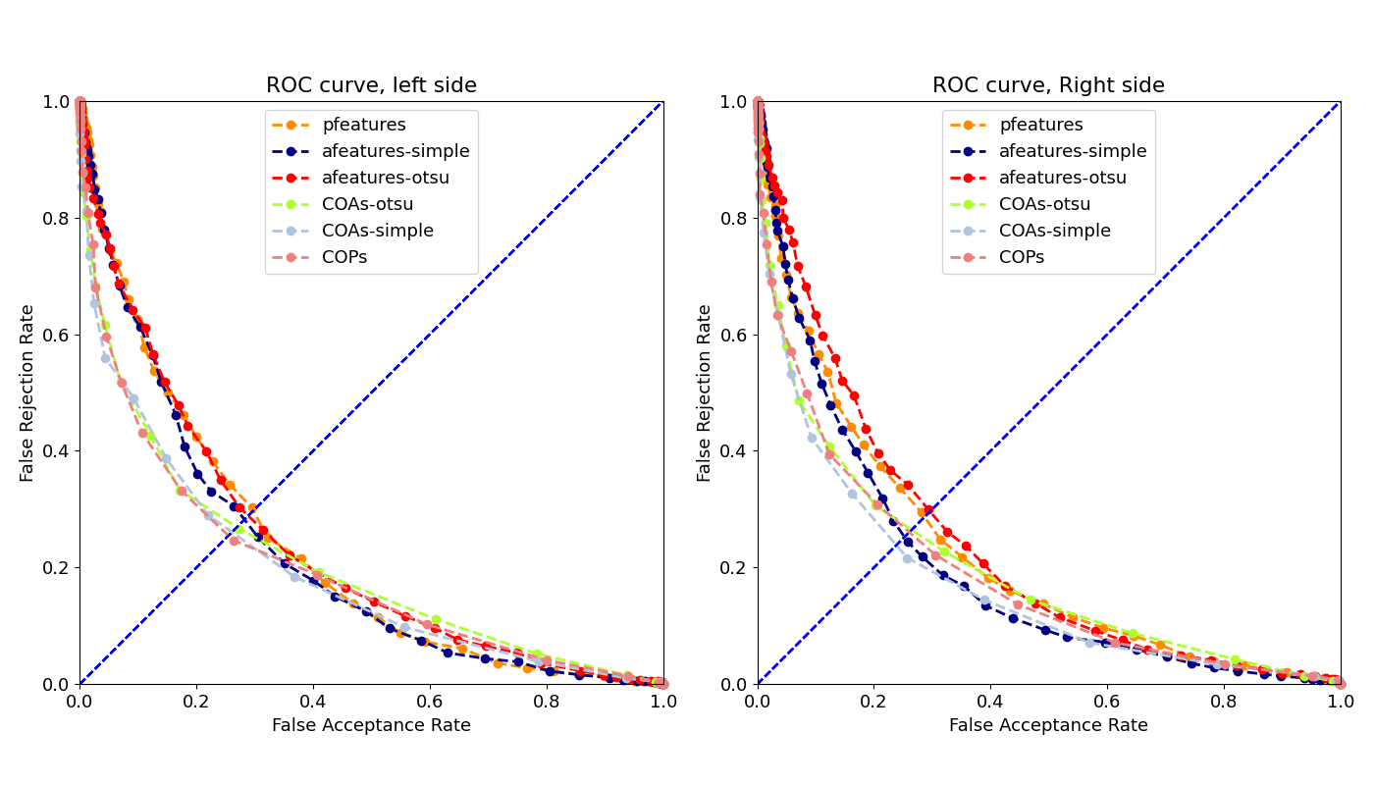
Feature types
For each subject, two models were developed, left and right. As a result, we have 2*96 models, and these two plots are obtained from the average of FAR and FRR in these models.

Slide 35
Conclusions
Minimum distance has a better result than median and average.
Although applying PCA has reduced the accuracy, It was selected since it reduced the feature space.
In time-series, the number of features with keeping 95% variance decreased from 300 to about 16.
In handcraft features, the number of features with keeping 95% variance decreased from 26 to about 6.
Z-score has a better result in comparison with Min-Max.
30% test size provided a good trade-off between test samples and accuracy.
COA Time-Series has better results in comparison with other types of features.

Slide 36
Work sheet 4
This Worksheet fucus on finding the best features set for our template matching model.
Aim 1: To compare different handcrafted features in term of different algorithm
Notes:
For worksheet 3, we are going to compare the performance of different Normalization algorithms,
PCA, criteria, test size, and type of features.

Slide 37
Features selection (handcrafted COP features)
 | D-prime | F-ratio | mRMR-Dif | mRMR-Q | Redundancy
0 | MFREQ_ML | MDIST_RD | MFREQ_ML | MFREQ_ML | FDPD_AP
1 | AREA_CE | TOTEX_AP | FDCE | FDCE | FDPD_ML
2 | FDCE | MVELO_AP | AREA_CE | MFREQ_RD | MFREQ_ML
3 | MDIST_RD | RANGE_AP | MFREQ_RD | FDPD_RD | FDCE
4 | MFREQ_RD | RANGE_RD | FDPD_RD | AREA_CE | MFREQ_AP
5 | FDPD_RD | MDIST_AP | MDIST_RD | FDPD_AP | MFREQ_RD
6 | MDIST_AP | AREA_CE | MDIST_ML | MDIST_ML | FDCC
7 | MDIST_ML | MFREQ_ML | MDIST_AP | MDIST_RD | FDPD_RD
8 | TOTEX_AP | MFREQ_RD | FDCC | MDIST_AP | RANGE_ML
9 | MVELO_AP | FDCE | RDIST_ML | FDCC | MDIST_ML
16 | TOTEX_ML | FDPD_AP | MVELO_ML | TOTEX_ML | MVELO_AP
17 | MFREQ_AP | RDIST_ML | TOTEX_ML | MVELO_ML | TOTEX_AP
18 | RDIST_AP | MFREQ_AP | FDPD_ML | RDIST_RD | RANGE_RD
19 | AREA_CC | MVELO_ML | RDIST_RD | RDIST_AP | RANGE_AP
20 | RANGE_ML | TOTEX_ML | RANGE_ML | RANGE_ML | MDIST_RD
21 | FDPD_AP | RANGE_ML | RDIST_AP | AREA_CC | RDIST_AP
22 | AREA_SW | AREA_SW | AREA_CC | FDPD_ML | AREA_CC
23 | FDPD_ML | MVELO_RD | AREA_SW | AREA_SW | TOTEX_RD
24 | MVELO_RD | TOTEX_RD | TOTEX_RD | TOTEX_RD | MVELO_RD
25 | TOTEX_RD | FDPD_ML | MVELO_RD | MVELO_RD | RDIST_RD
The Left foot of the first subject

Slide 38
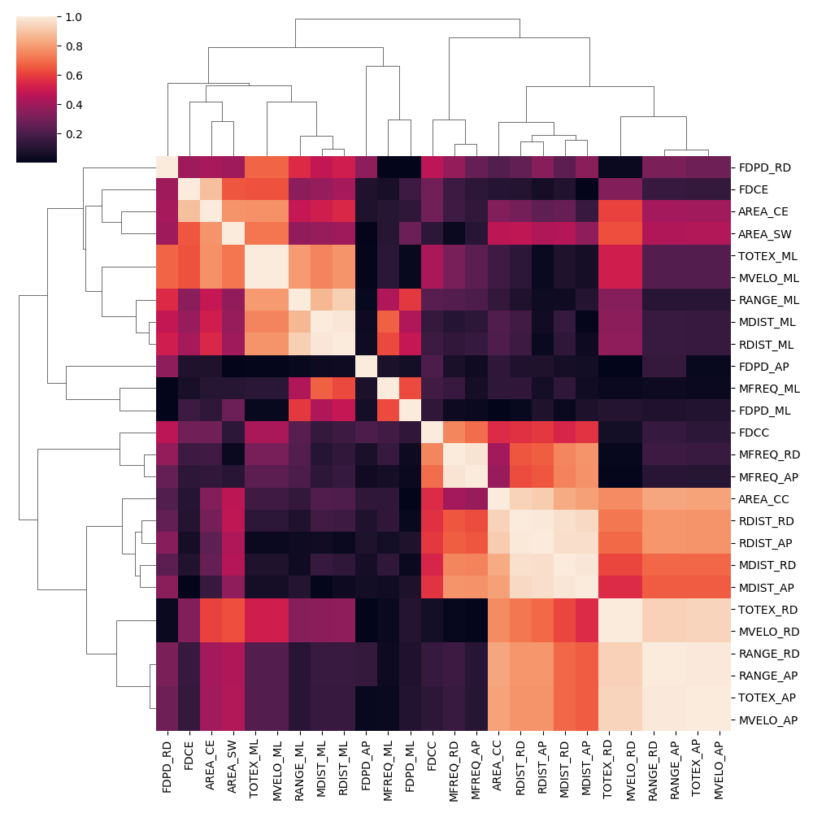
Features selection (handcrafted COP features)

Slide 39
Features selection (handcrafted COP features)
FDPD_RD
FDCE, AREA_CE, AREA_SW
TOTEX_ML, MVELO_ML, RANGE_ML, MDIST_ML, RDIST_ML,
FDPD_AP
MFREQ_ML, FDPD_ML
FDCC, MFREQ_RD, MFREQ_AP
AREA_CC, RDIST_RD, RDIST_AP, MDIST_RD, MDIST_AP
TETEX_RD, MVELO_RD, RANGE_RD, MVELO_AP, RANGE_AP, TETEX_AP

Slide 40
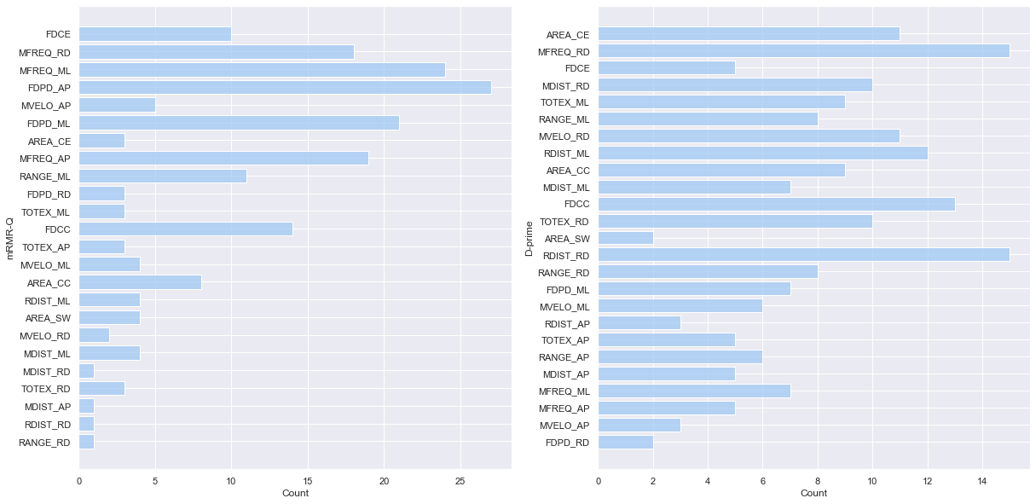
Features selection (handcrafted COP features)
These plots show the best feature among all subjects (models) in terms of the repeatability of the feature in the first rank. For example, FDPD_AP became the first rank for 26 models (subjects) in the mRMR algorithm. Each plot shows the output of a different algorithm.

Slide 41
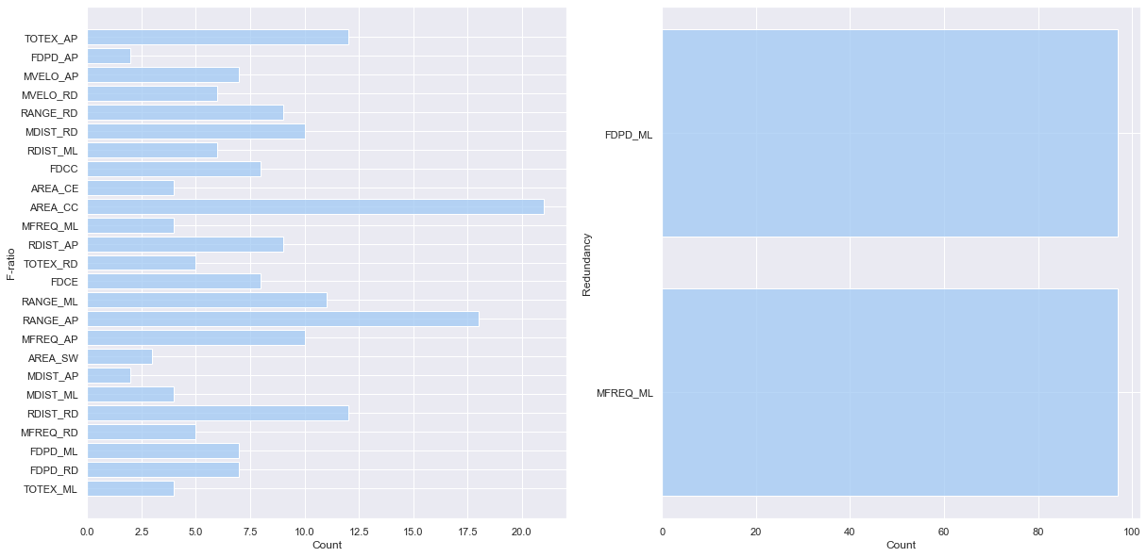
Features selection (handcrafted COP features)
These plots show the best feature among all subjects (models) in terms of the repeatability of the feature in the first rank.

Slide 42
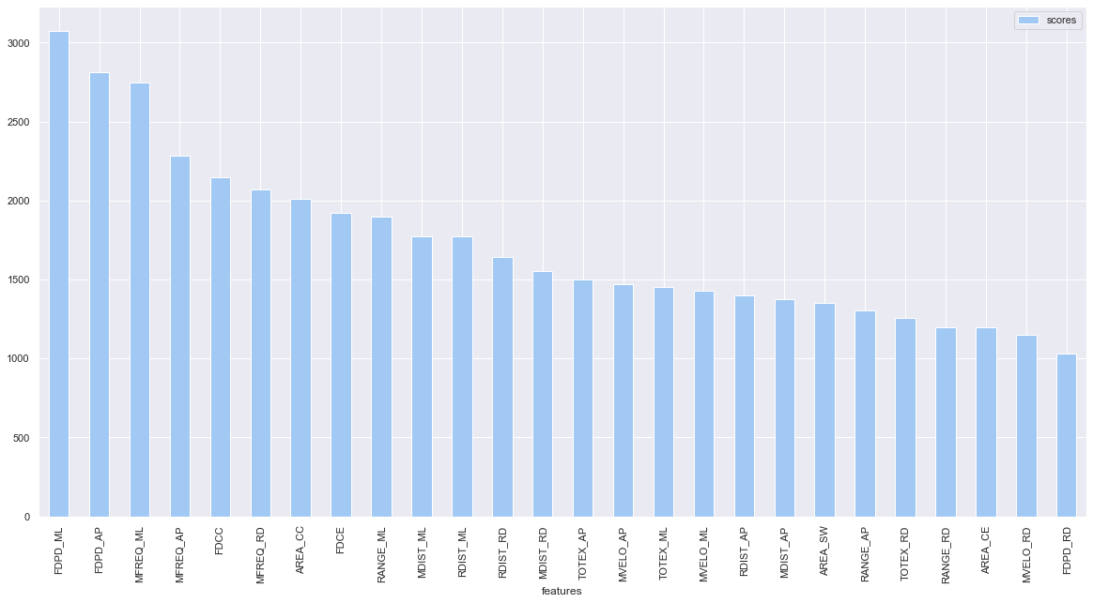
Features selection (handcrafted COP features)
The best feature set among all subjects (models). For each features based on its rank in feature selection algorithm, a point was considered and then find the 10-top feature across all subjects.

Slide 43
Conclusions
Based on mRMR, MFREQ and FDPD for both AP and ML are the best features set across all models.

